Slide 1
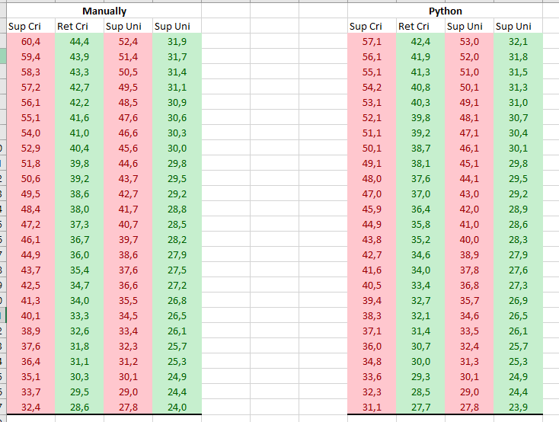
Building 1

Slide 2
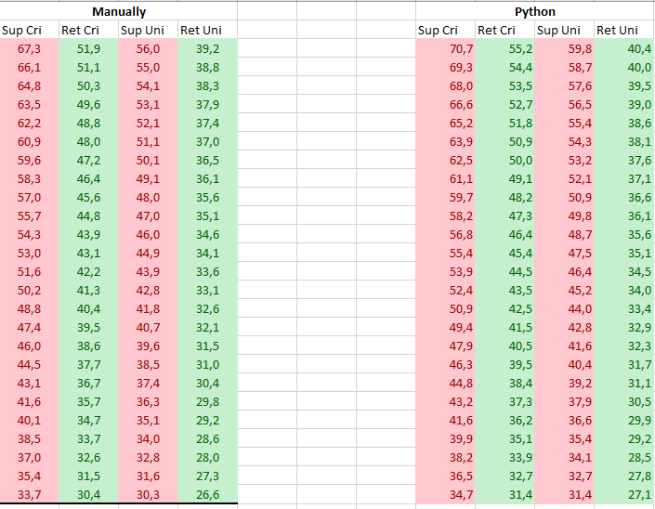
Building 2

Slide 3
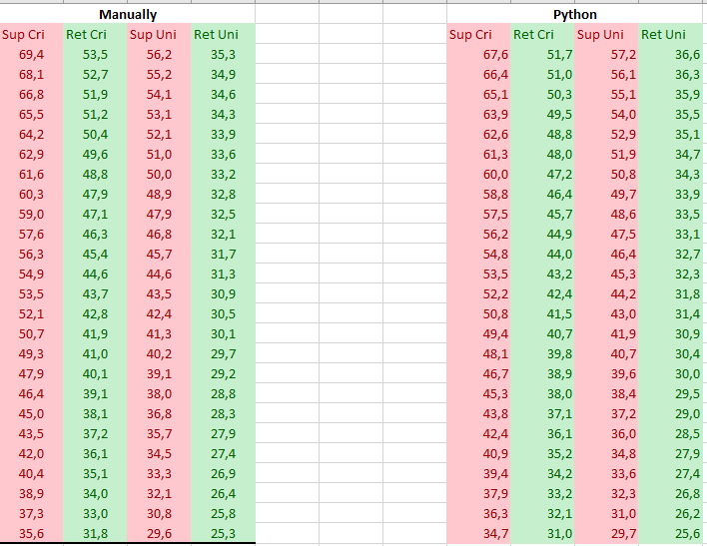
Building 3

Slide 4
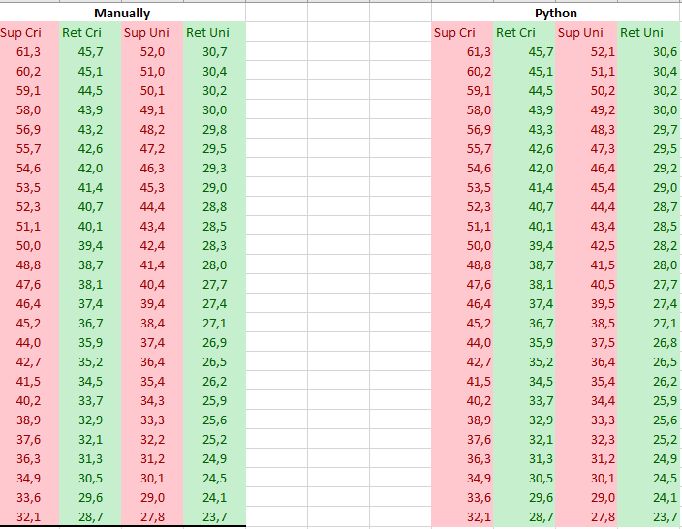
Building 4

Slide 5
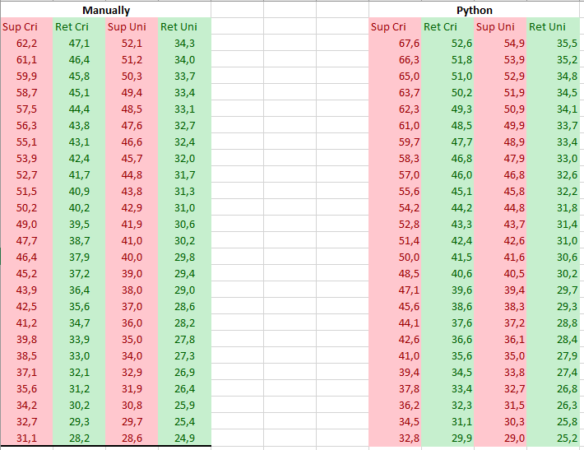
Building 5

Slide 6
Problems
1. Capacity 1)Missing capacity. 2) Meter No. Cannot match.
2. Name of basement random, 9999, fika fikb, 55, 56
3. Mass flow, previous mass flow considered the total energy(including the basement), now exclude the basement

